Slide 1

Department of Computer Science & Engineering Artificial Intelligence & Machine Learning
A.P. Shah Institute of Technology
G.B.Road, Kasarvadavli, Thane(W), Mumbai- 400615
UNIVERSITY OF MUMBAI
Academic Year 2023-2024

Slide 2

IOT Based Weather Monitoring System
Computer Science & Engineering Artificial Intelligence and Machine Learning
By
Maitreyi Phadke (22106007)
Rutuja Pawar (22106043)
Gauri Ramekar (22106068)
Pratiksha Pathak (22106127)
Under the Guidance of Prof. Monali Korde

Slide 3
INDEX
Introduction
Components
Circuit Diagram
Flowchart
Tools/Softwares Used
Algorithm
Implementation
Application
Benefits
Conclusion

Slide 4
INTRODUCTION
IOT: The Internet of Things (IoT) describes the network of physical objects—“things”—that are embedded with sensors, software, and other technologies for the purpose of connecting and exchanging data with other devices and systems over the internet. Now that we can connect everyday objects—kitchen appliances, cars, thermostats, baby monitors—to the internet via embedded devices, seamless communication is possible between people, processes, and things.
IOT Based Weather Monitoring system involves in acquiring weather and environment data using advanced electronic sensors and sending them to a web server via internet for real time weather monitoring and storage of data for future analysis and study.

Slide 5
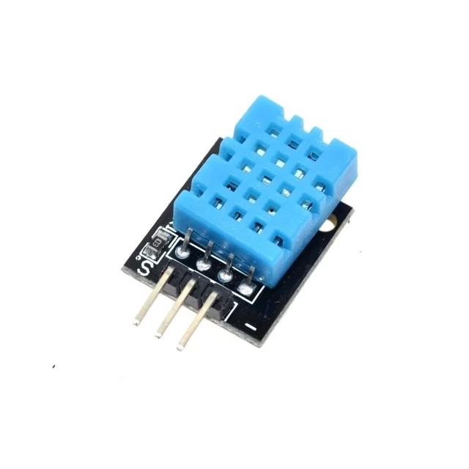
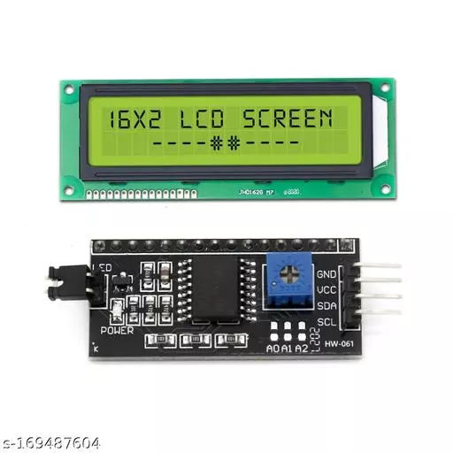
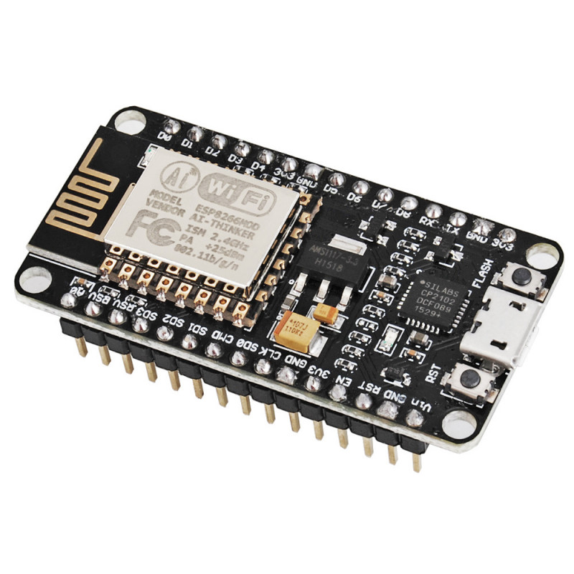
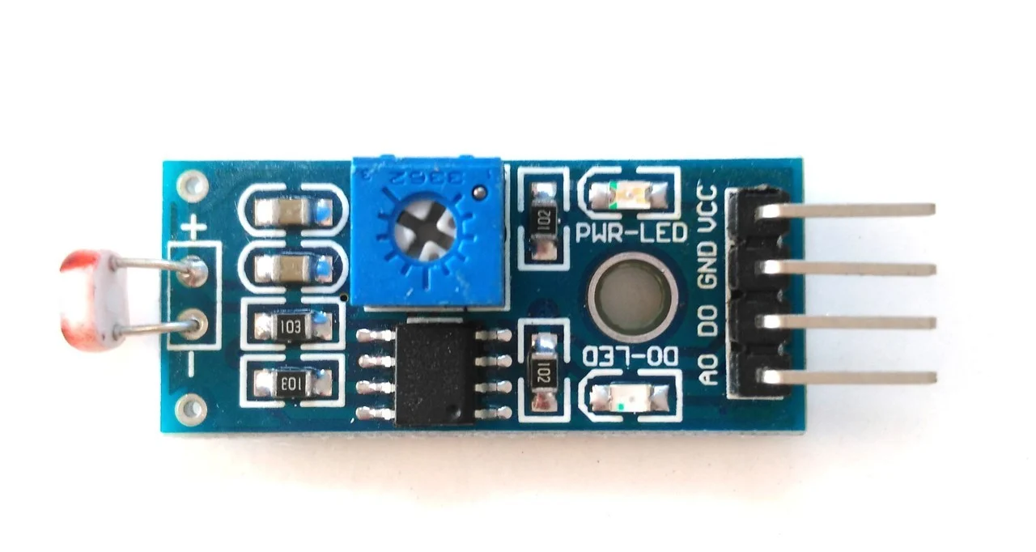
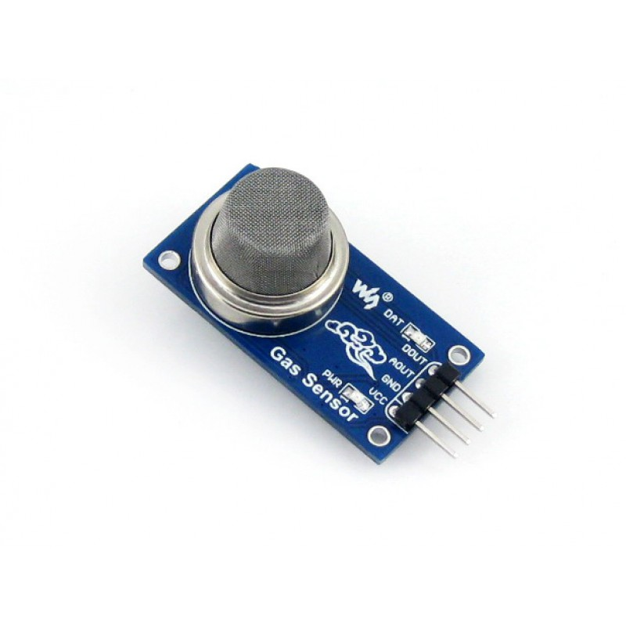
COMPONENTS OF THE SYSTEM
NodeMCU ESP8266 WiFi Module
DHT11 Temperature And Humidity Sensor
16 x 2 display with I2C adapter module
LDR Sensor LM393
MQ-135 sensor air quality sensor.

Slide 6

BLOCK DIAGRAM
DHT11 Temperature and Humidity Sensor
NodeMCU ESP8266 WiFi Module
Arduino IOT CLOUD
LDR Sensor LM393
Dashboard
MQ-135 Air Quality Sensor

Slide 7
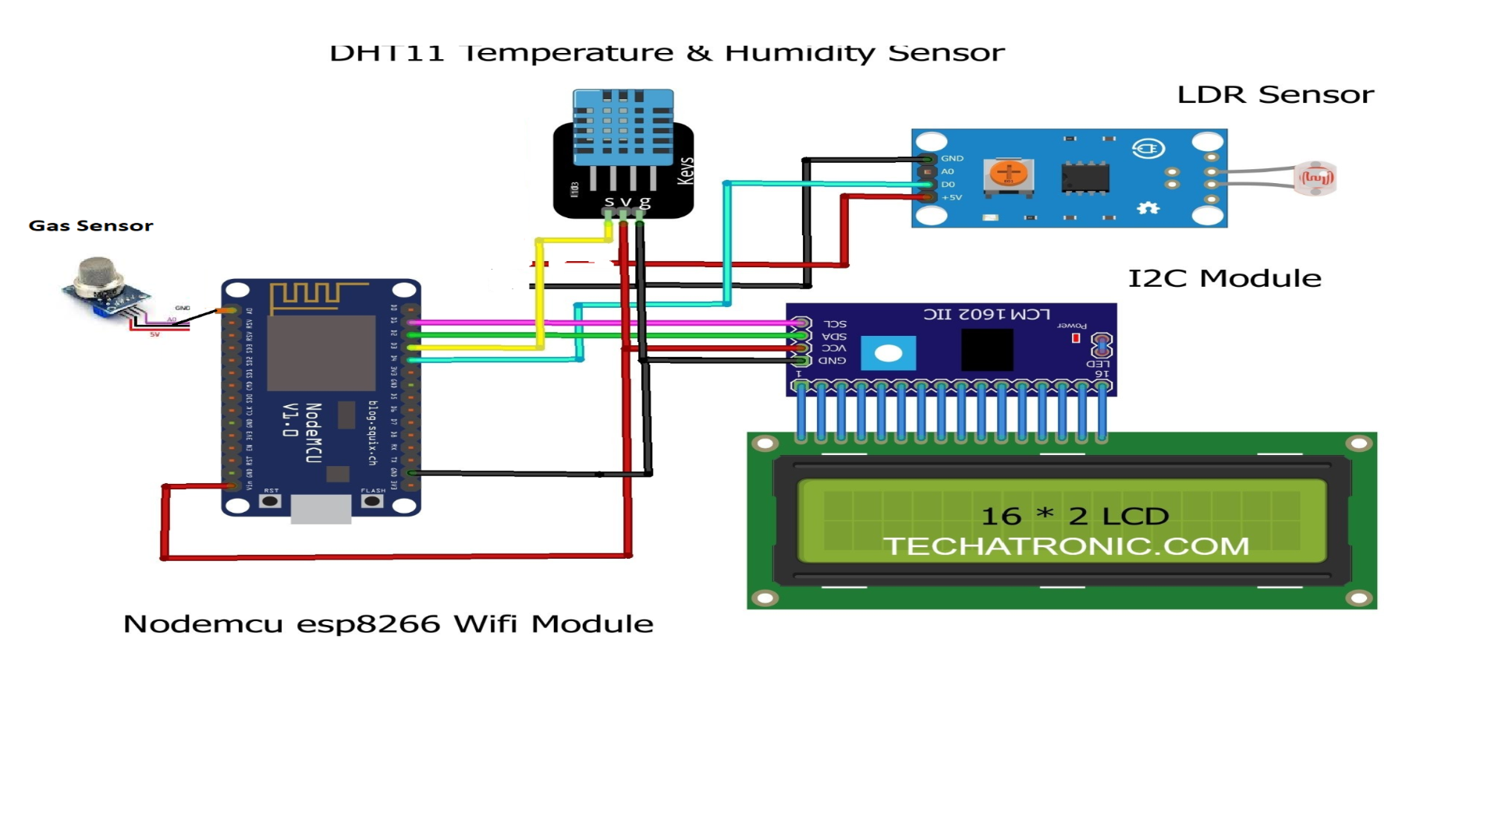
CIRCUIT DIAGRAM

Slide 8


TOOLS/SOFTWARES, LANGUAGES USED
ARDUINO IOT CLOUD

Slide 9
ALGORITHM
Initialization:
Include necessary libraries, "thingProperties.h" for IoT Cloud communication and "DHT.h" for the DHT sensor.
Define constants: DHTpin specifies the sensor's data pin (D4 on NodeMCU ESP8266), and DHTTYPE specifies the DHT sensor type (DHT11).
Create a DHT sensor object (dht) using the specified pin and type.
Setup Function (setup()):
Initialize serial communication with a baud rate of 9600 for debugging.
Add a delay of 1500 milliseconds to allow time for the Serial Monitor to open if used.
Initialize IoT Cloud properties using the initProperties() function from "thingProperties.h."
Connect to the Arduino IoT Cloud using ArduinoCloud.begin(ArduinoIoTPreferredConnection).
Set the debug message level to 2 for more detailed debugging information.
Print debug information to the Serial Monitor using ArduinoCloud.printDebugInfo().

Slide 10
3. Loop Function (loop()):
Continuously update the Arduino IoT Cloud connection and properties using ArduinoCloud.update().
Call the dht_sensor_getdata() function to read temperature and humidity data from the DHT11 sensor.
4. DHT Sensor Data Function (dht_sensor_getdata()):
Read the humidity value from the DHT11 sensor and store it in the hm variable.
Print the humidity value to the Serial Monitor.
Read the temperature value from the DHT11 sensor and store it in the temp variable.
Print the temperature value to the Serial Monitor.
Update the IoT Cloud variables humidity and temperature with the new values.
Construct a message (msg) containing both temperature and humidity values in a formatted string.
5. Variable Change Callbacks (onHumidityChange() and onMsgChange()):
These functions are currently empty and serve as placeholders for actions that can be taken when IoT Cloud variables are changed. You can customize these functions to implement specific actions based on humidity and message data changes

Slide 11
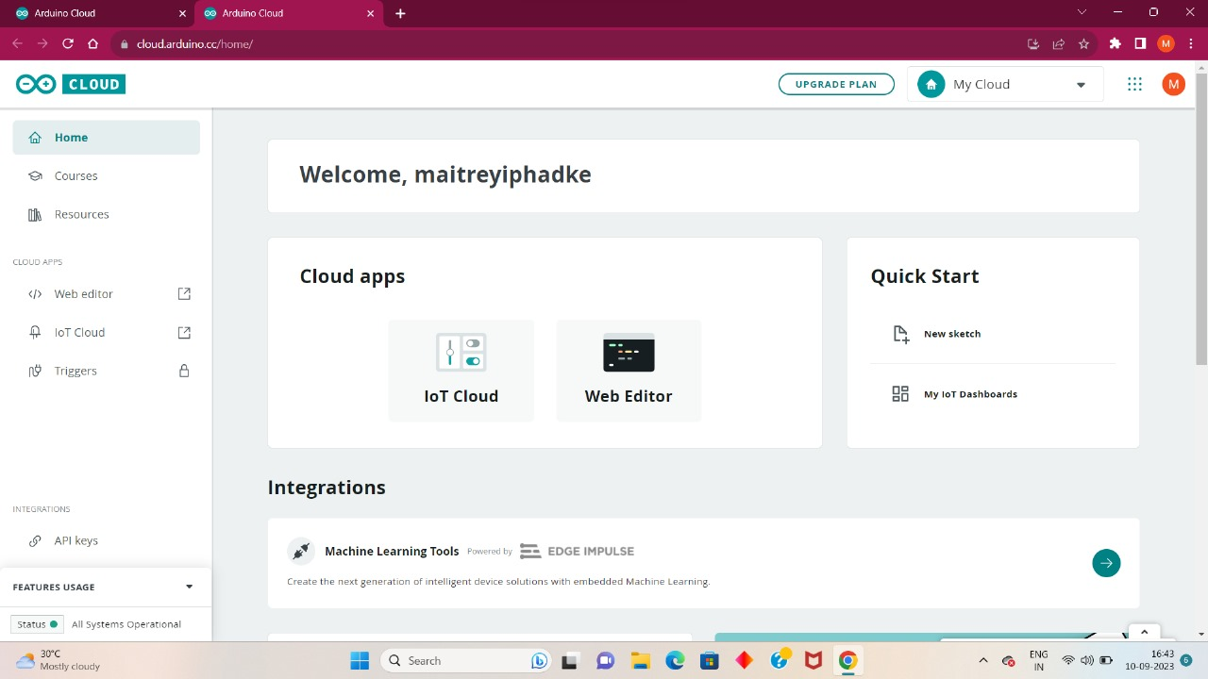
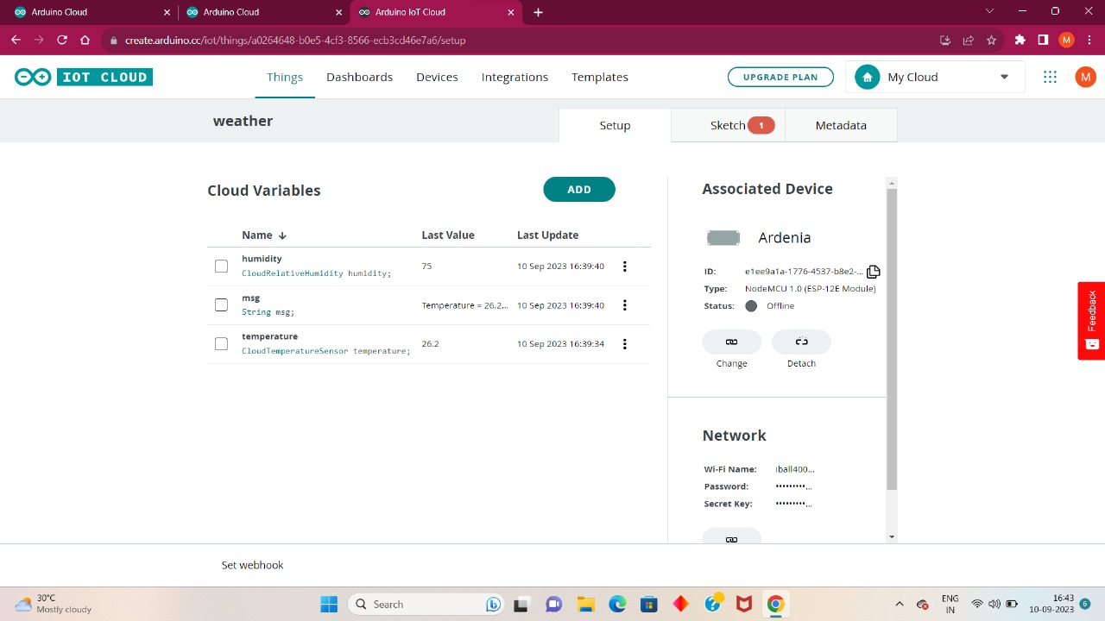
ARDUINO IOT CLOUD

Slide 12
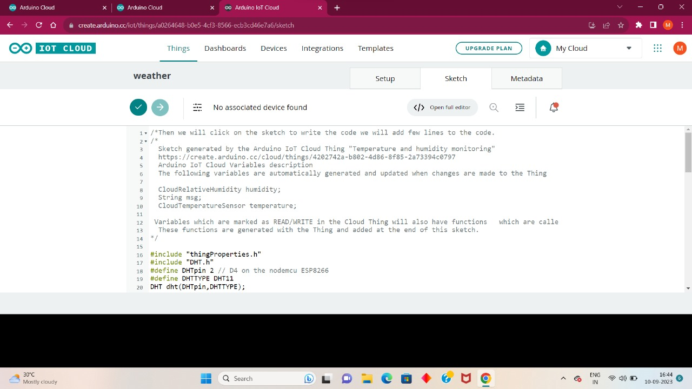
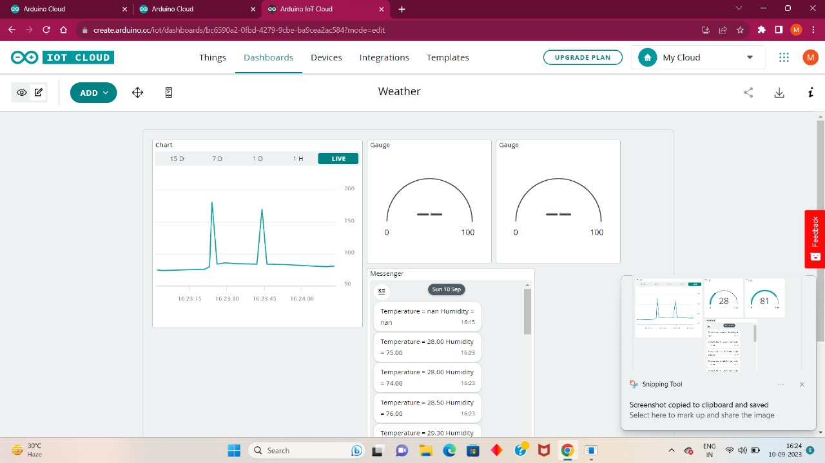
ARDUINO IOT CLOUD

Slide 13
APPLICATIONS
Agriculture
Transportation
Infrastructure Maintenance
Research and Education
Healthcare
Construction
Smart Cities

Slide 14
BENEFITS
Real-time Data
Data Accuracy
Remote Monitoring
Environmental Monitoring
Data-Driven Decision Making
User-Friendly Interfaces
Improved Public Safety

Slide 15
CONCLUSION
We Conclude That The Weather Reporting System Using IoT Is Quite Cost Effective, Efficient And The Data Collected Can Also Be Post On Cloud As Well. Hence, This System Is Useful In Continuous Monitoring Of The Environment.
The project uses a 16x2 LCD display to display sensor data, with an I2C display module to reduce wire connections.
MQ-135 is an analog air quality sensor which takes air samples from your surroundings. The Analog Output is connected to A0.
LDR is responsible for collecting data about the intensity of light at your surroundings. The D0 pin is connected to D4 of NodeMCU.

Slide 16
THANK YOU

